Slide 1
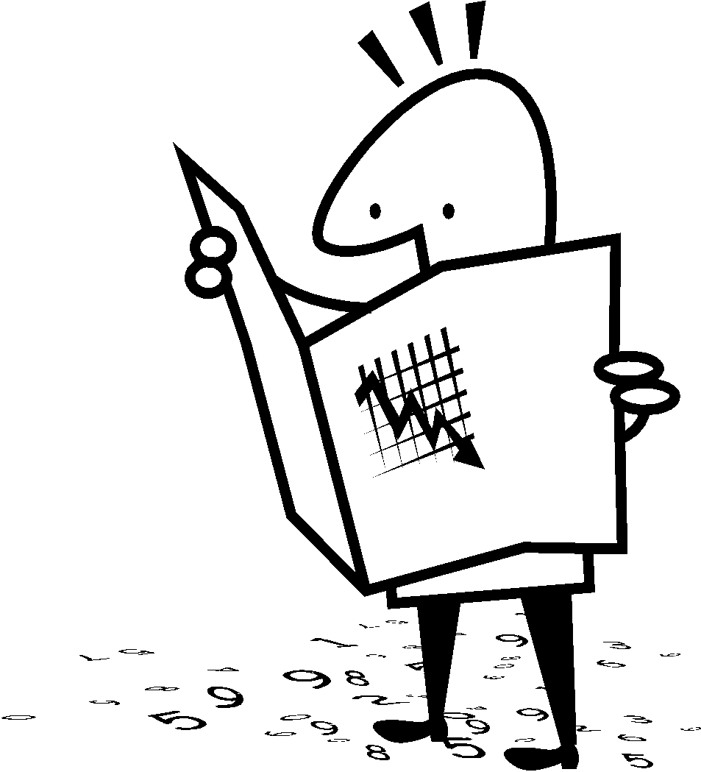
Identifying the Elements of A Plot Diagram
Student Notes

Slide 2
Plot Diagram
3
4
2
1
5

Slide 3
Plot (definition)
Plot is the organized pattern or sequence of events that make up a story. Every plot is made up of a series of incidents that are related to one another.

Slide 4
1. Exposition
This usually occurs at the beginning of a short story. Here the characters are introduced. We also learn about the setting of the story. Most importantly, we are introduced to the main conflict (main problem).

Slide 5
2. Rising Action
This part of the story begins to develop the conflict(s). A building of interest or suspense occurs.

Slide 6
3. Climax
This is the turning point of the story. Usually the main character comes face to face with a conflict. The main character will change in some way.

Slide 7
4. Falling Action
All loose ends of the plot are tied up. The conflict(s) and climax are taken care of.

Slide 8
5. Resolution
The story comes to a reasonable ending.

Slide 9
Putting It All Together
1. Exposition
2. Rising Action
3. Climax
4. Falling Action
5. Resolution
Beginning of Story
Middle of Story
End of Story

