Slide 1
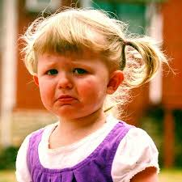
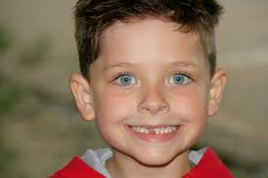
Positive and Negative Incentives

Slide 2
Positive incentives reward people for making certain choices or behaving in a certain way.
What are some examples of positive incentives?
-Free time
-Higher pay
Positive Incentives make us feel happy.

Slide 3
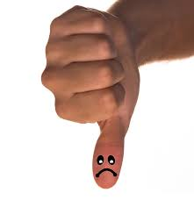
Negative incentives penalize people for making certain choices or behaving in a certain way.
What are some examples of negative incentives?
-loss of a privilege
-something taken away
Negative Incentives make us feel sad.

Slide 4
