Slide 1
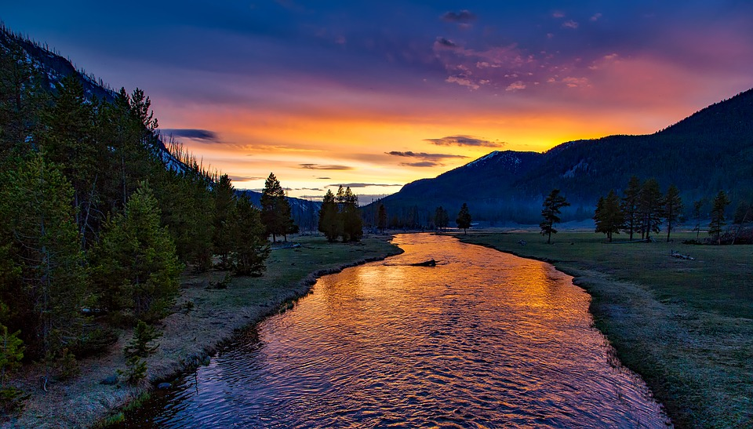
Conserving Resources
Why should we think about conserving Earth’s resources?

Slide 2
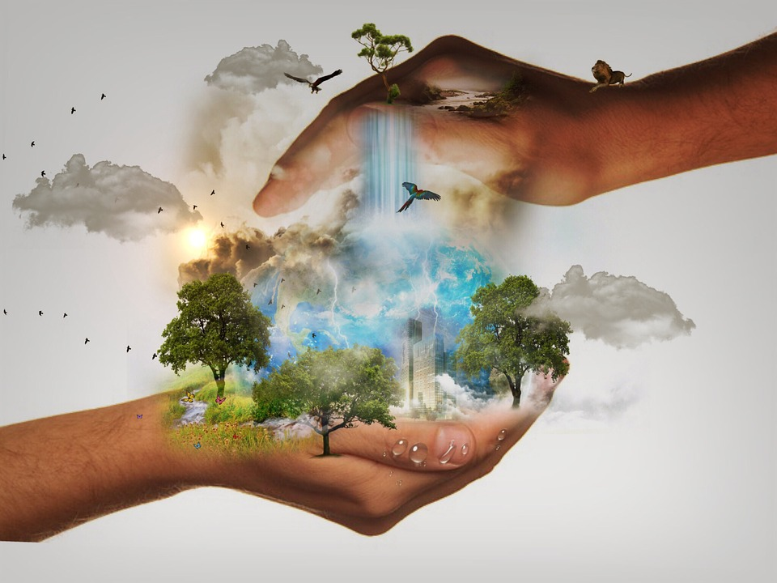
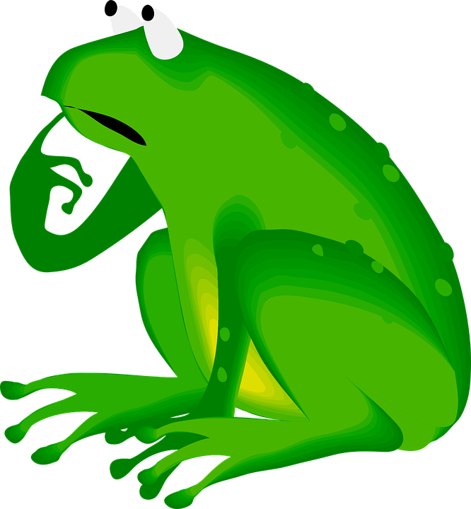
When we conserve something, we don’t waste it. We try NOT to use it up. It is important that natural resources like air water and trees, are conserved, or used carefully.
Watch the following video about saving trees.
What is one way that you can conserve paper at school or at home?

Slide 3
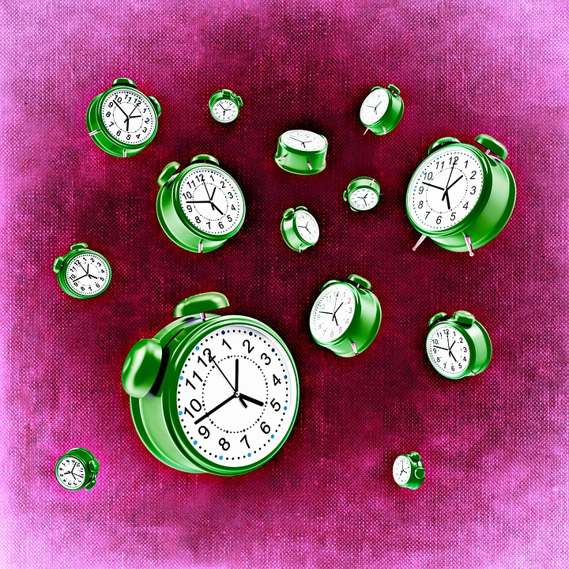
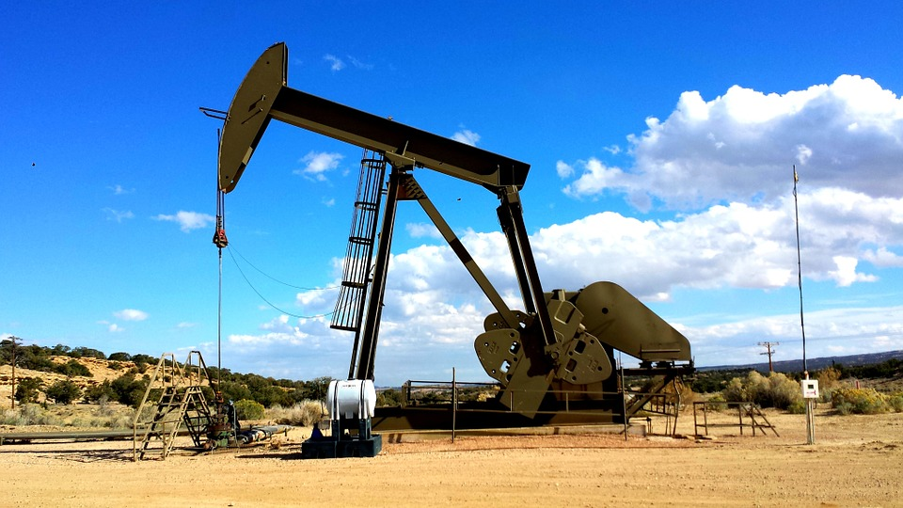
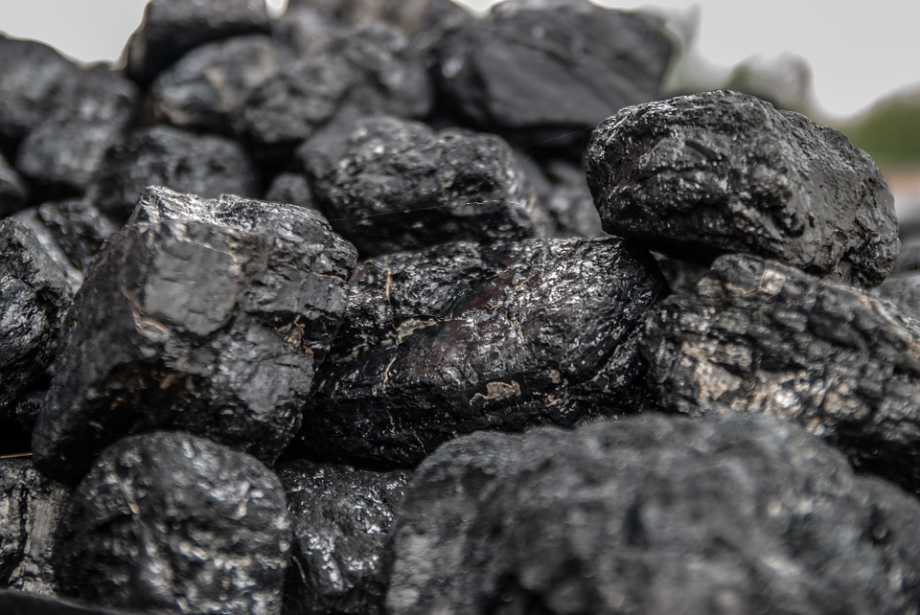
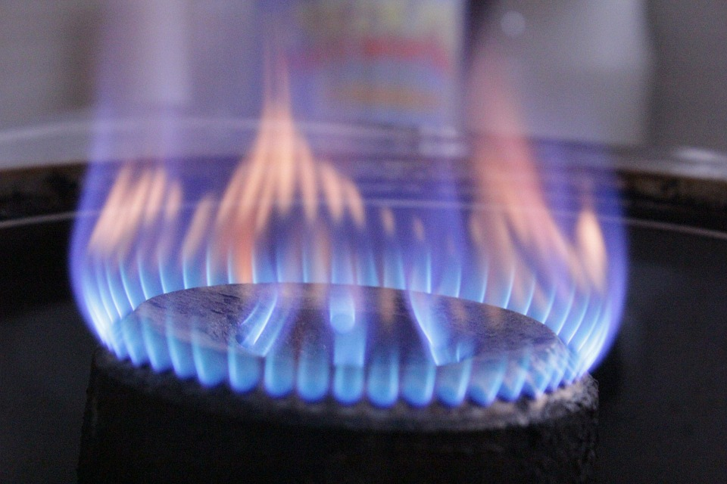
Nonrenewable resources like, oil, coal, and natural gas, are called fossil fuels. Since fossil fuels can be used up, it is very important that we conserve these resources. If we run out of these resources, it takes millions of years to make more.

Slide 4
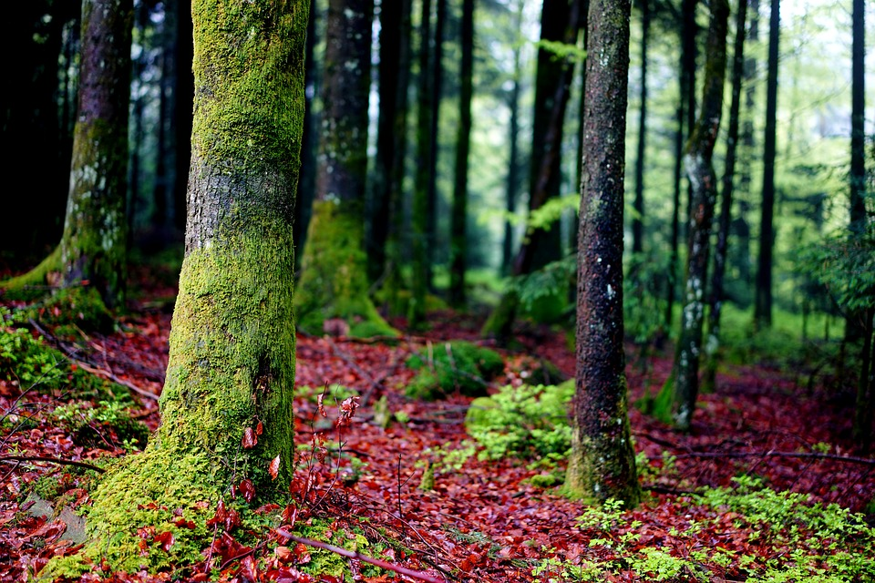
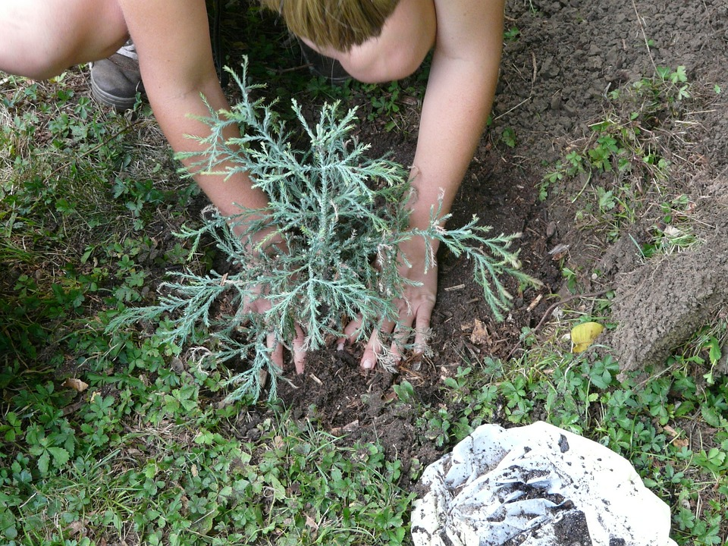
We also need to conserve our renewable resources. Renewable resources such as trees, can be used up, or depleted. Even though trees renew themselves through seeds, they can be used up by humans if we don’t plant new trees to replace the trees we cut down.

Slide 5
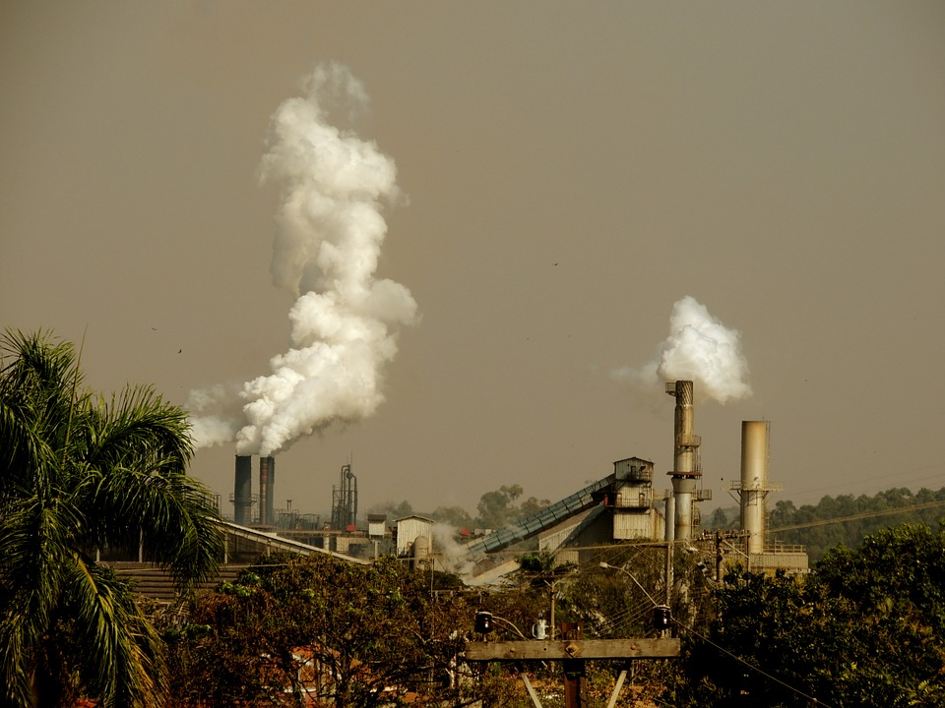
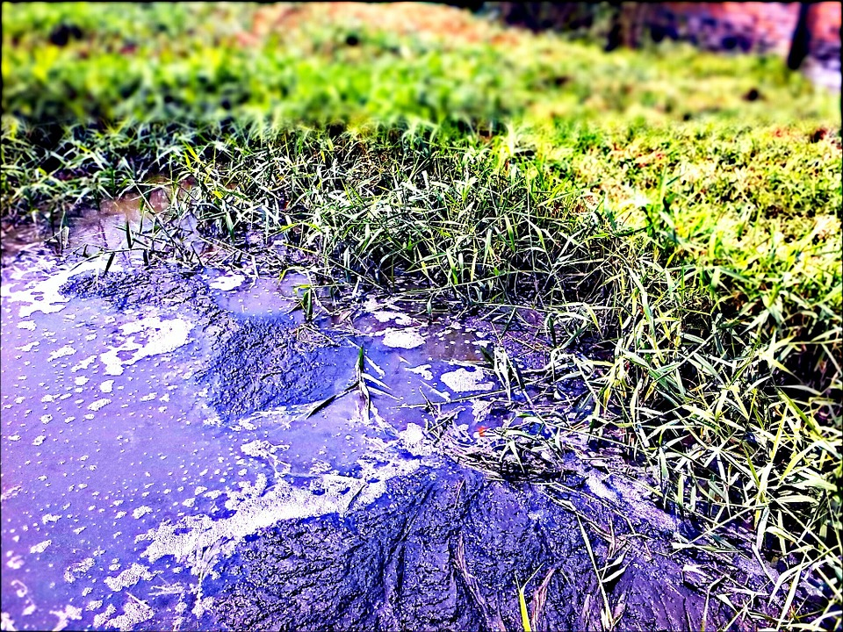
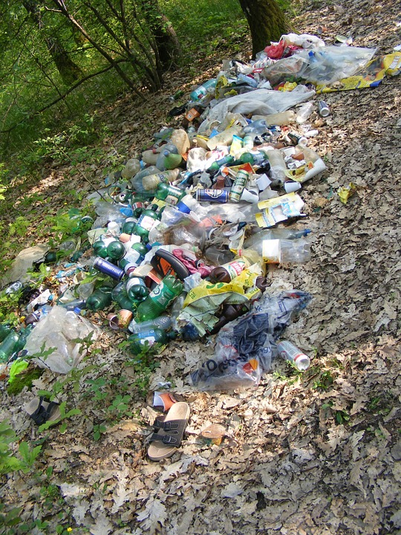
So how can we conserve our natural resources? One way to help conserve our natural resources is by being responsible and not polluting our air, land and water. Harmful chemicals from burning materials or from oil spills can hurt or kill plant and animal life. They also pollute the air we breathe and the water we drink.

Slide 6
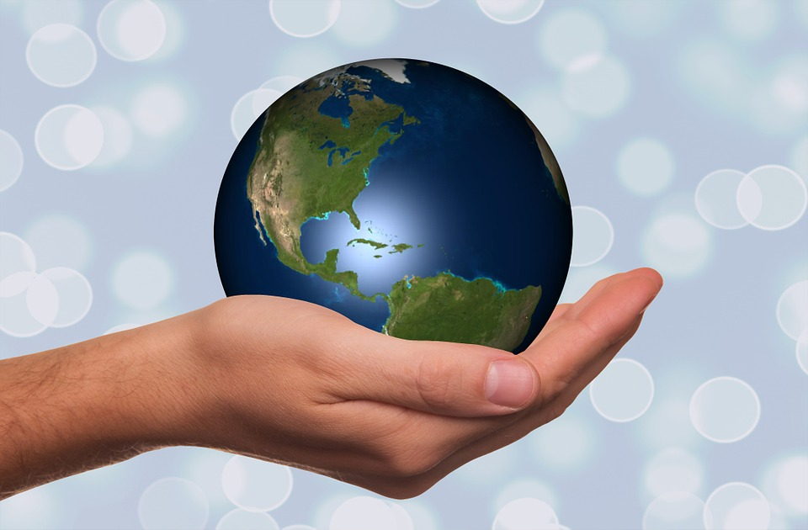
Another way we can help conserve our natural resources is to reduce, reuse, and recycle materials.
What does it mean to reduce, reuse, and recycle?

Slide 7
Reduce means to use less of something. You can reduce the amount of water your family uses by taking shorter showers and by not letting the water run when you brush your teeth. Using less water saves money and helps conserve our water supply.
Watch the video on reducing waste. Think about one way you can reduce waste at home.

Slide 8
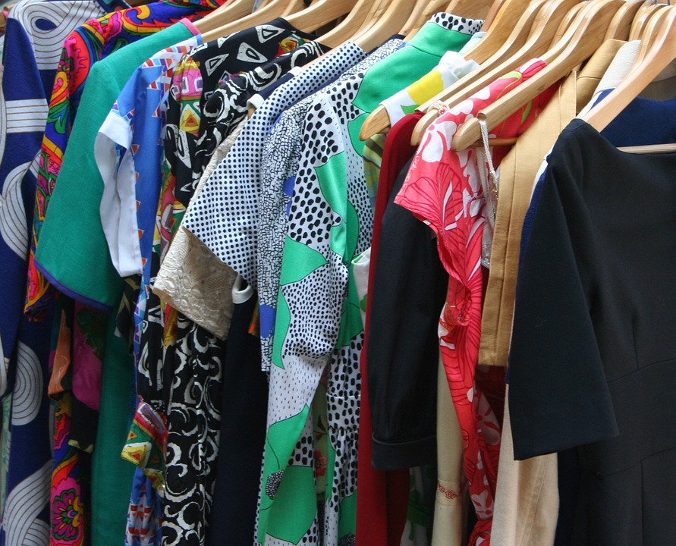
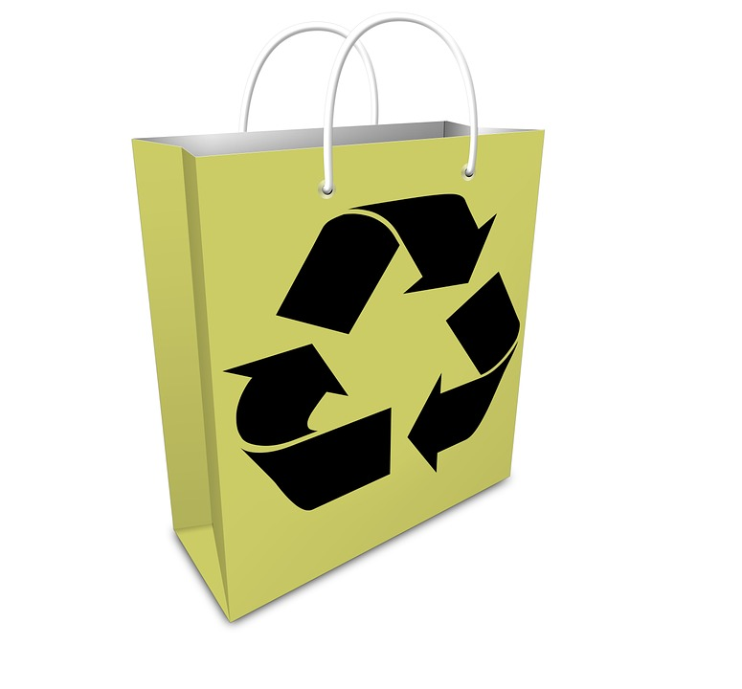
Reuse means to use something, you use it again. For example, instead of throwing something away, try to find a way to use it again. Take clothes that no longer fit to a donation center so someone else can use them. Reusing clothes, decreases the amount of waste in landfills.
Does your family reuse anything at home?

Slide 9
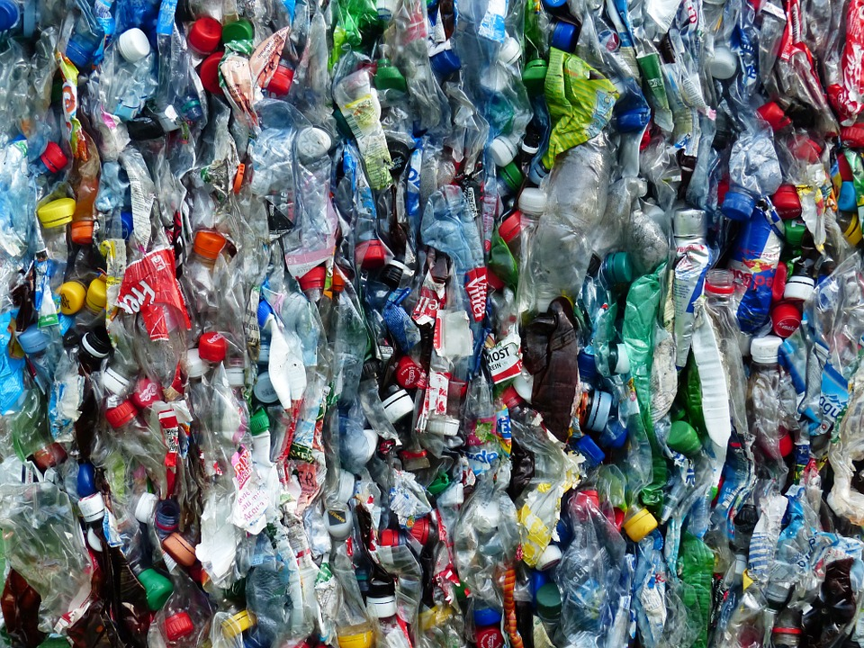
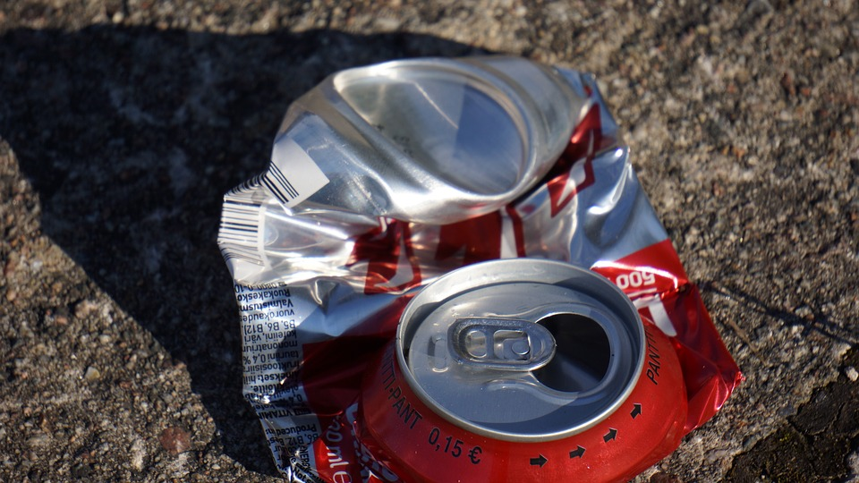
Recycle means to use something over. You can recycle pop cans or plastic bottles so they can be used again. Recycling also decreases the amount of waste in landfills.
Watch this short video about recycling from our recycling center in Bowling Green.

Slide 10
Now it’s your turn!
You will be creating a google slide to show why conserving resources is important.
Think about an important resource.. In your slide, write a few sentences that tell what the resource is, why this resource is important, and one thing you can do to help conserve this resource. Include a picture or two that shows your resource. Use this link, Pics4Learning, to search for pictures for your google slide..
Teacher’s Note:
See the lesson plan write up for how to create and manage the student created slides.

